Slide 1
Fundamentals of Microsoft Teams
Anders Dissing, Microsoft Office Servers and Services MVP

Slide 2

Teams application packaging and testing
Teams-extensibility options
What is a Teams App?
Why create a Teams App?
How to create a Teams App
Demo

Slide 3
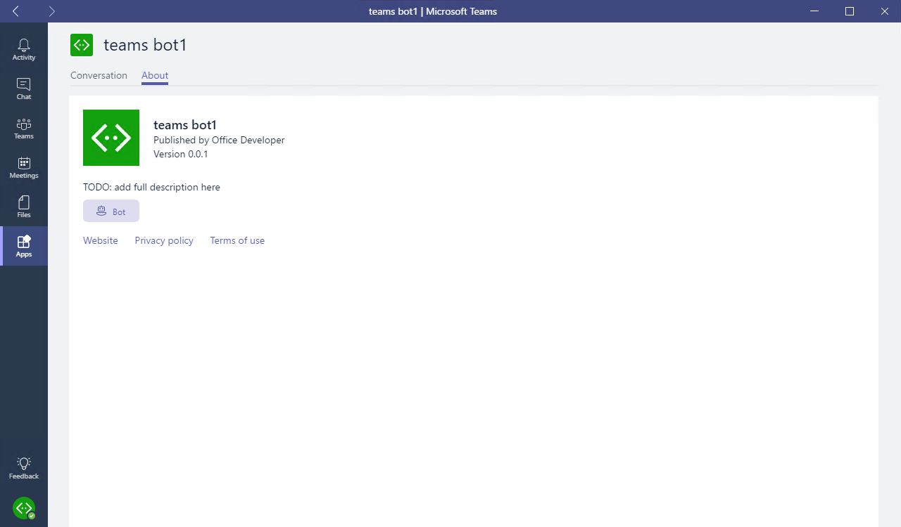
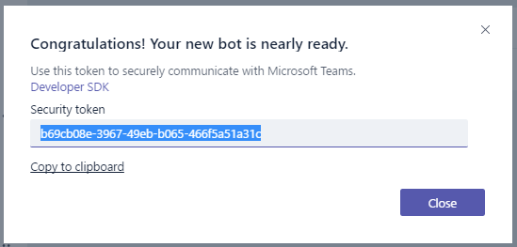
Teams-extensibility options
Microsoft Teams App
Tabs
Bots
Compose extensions
Connectors
Custom Bot
Receive & reply to messages
Notes:
For the best and most extensible option for adding your service into Teams, create a Microsoft Teams app. A Microsoft Teams app is a package of services that you host, that can be distributed through the Teams product or sideloaded by teams.
For quick one-off integration of your existing webhook, you can take advantage of our Custom Bot feature. This ad-hoc extensibility option allows you to simply set up webhooks / notifications in a specific team, with no additional coding required.

Slide 4
What is a Teams App?
Package of services available to users in the contexts (or “scopes”) that make the most sense.
Services
Tabs
Bots
Compose extensions
Connectors
Scopes
Personal (App bar)
Team (Channel)
Package (deployment)
Sideload (one Team)
Office Store
Notes:
Apps in Microsoft Teams allow you to make your service available to users in the contexts - or "scopes" - that make the most sense.
You declare precisely which capabilities you support, in which scopes, via your app package's manifest file.
You can use most app capabilities (such as bots, tabs, etc) in most scopes.
You offer these capabilities via a single Teams app package that users can acquire through our in-product app gallery, via the Office Store, or sideloaded directly by your team.

Slide 5


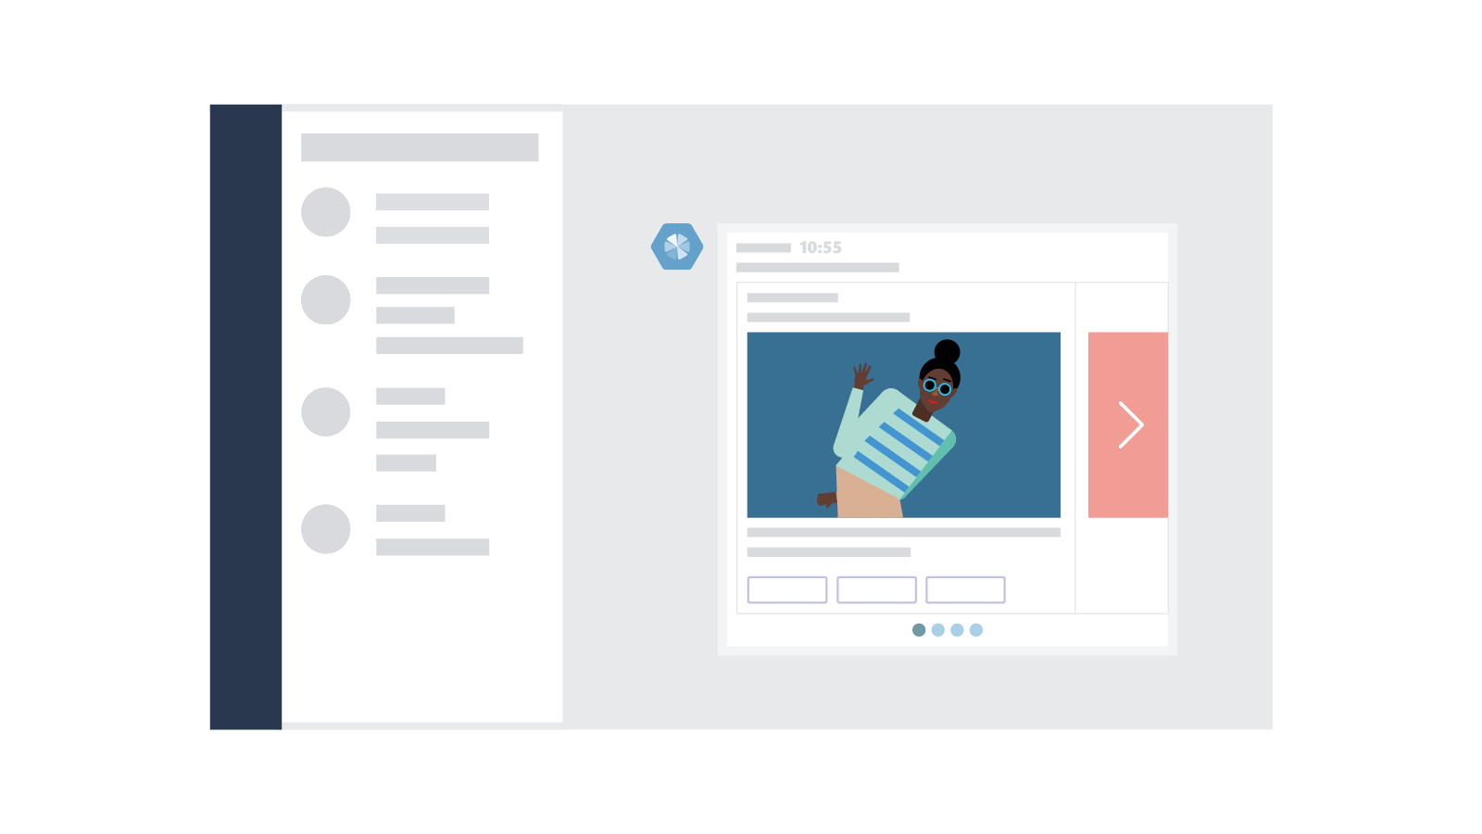


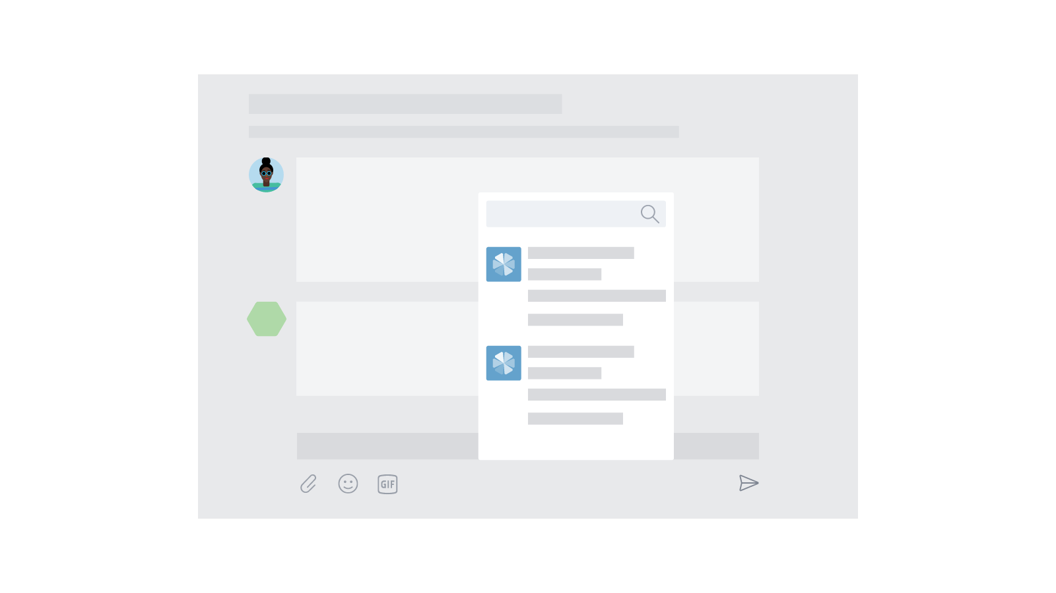
Why create a Teams App?
Immersive experience
The platform places content and conversations side by side.
Tabs and conversations
Tabs give your app a dedicated canvas that allows people to jump between conversations and your experience.
Customizable cards
Cards let you surface important tasks, information, and reminders in actionable ways.
Bot framework
The Bot framework offers a natural language UX that can interact with your services.
Instant notifications
The activity feed displays notifications for your users.
Compose extensions
Compose Extensions are quick and easy shortcuts to key components of your service.
Notes:
This information comes from the Microsoft Teams Design Guidelines: http://msteamsdesignguidelines.azurewebsites.net/#!/
All of these capabilities are possible in an app, not in a custom bot.
Not all are required. Only publish those that make sense, or start with one and build out over time.

Slide 6
Demo Create and test a basic Teams App using Yeoman
Notes:
Generated project:
Review folders: src, manifest, package
Review gulp tasks: manifest, build, serve
Source files:
*.html files: “inject” comments
Used to inject TypeScript compiled output into page
Net result is HTML/JavaScript in same page
Every page needs “microsoftTeams.initialize()”, and is called in TypeScript object constructor
webpack.config.js defines “output / library” around line 61. This library name is a namespace, used to qualify TypeScript objects

Slide 7
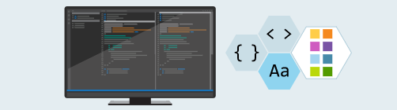
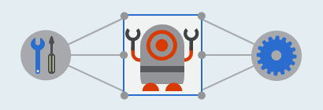

How to create a Teams App
Develop components
HTML
TypeScript / JavaScript
.NET
Integrate with Teams
Microsoft Teams JavaScript Library
Bot Builder SDK - Node.js & C#
Package and deploy
Host web pages and services
Create and package manifest
Sideload/publish package

Slide 8

Summary
Teams-extensibility options
See a simple Teams Tabs
How to deploy a Teams App

Slide 9

Build a basic Microsoft Teams Bot
Overview of building a Microsoft Teams Bot
Bot Framework vs Webhook (Custom Bot)
Conversation Basics
Channel Conversations and 1:1 Conversations
Messages, Cards and Actions
Events
Testing your Bot
DEMO

Slide 10
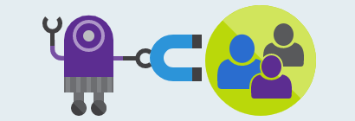


Overview of building a Microsoft Teams Bot
Design a great bot
Be responsive – respond to messages and events
Recognize and respond to questions and non-questions
Have a personality
Develop your bot
Bot Builder SDK for .NET
Bot Builder SDK for Node.js
Register and deploy your bot
Get a Bot ID and App ID/Secret and configure bot
Make sure bot is reachable from the internet
Enable analytics

Slide 11
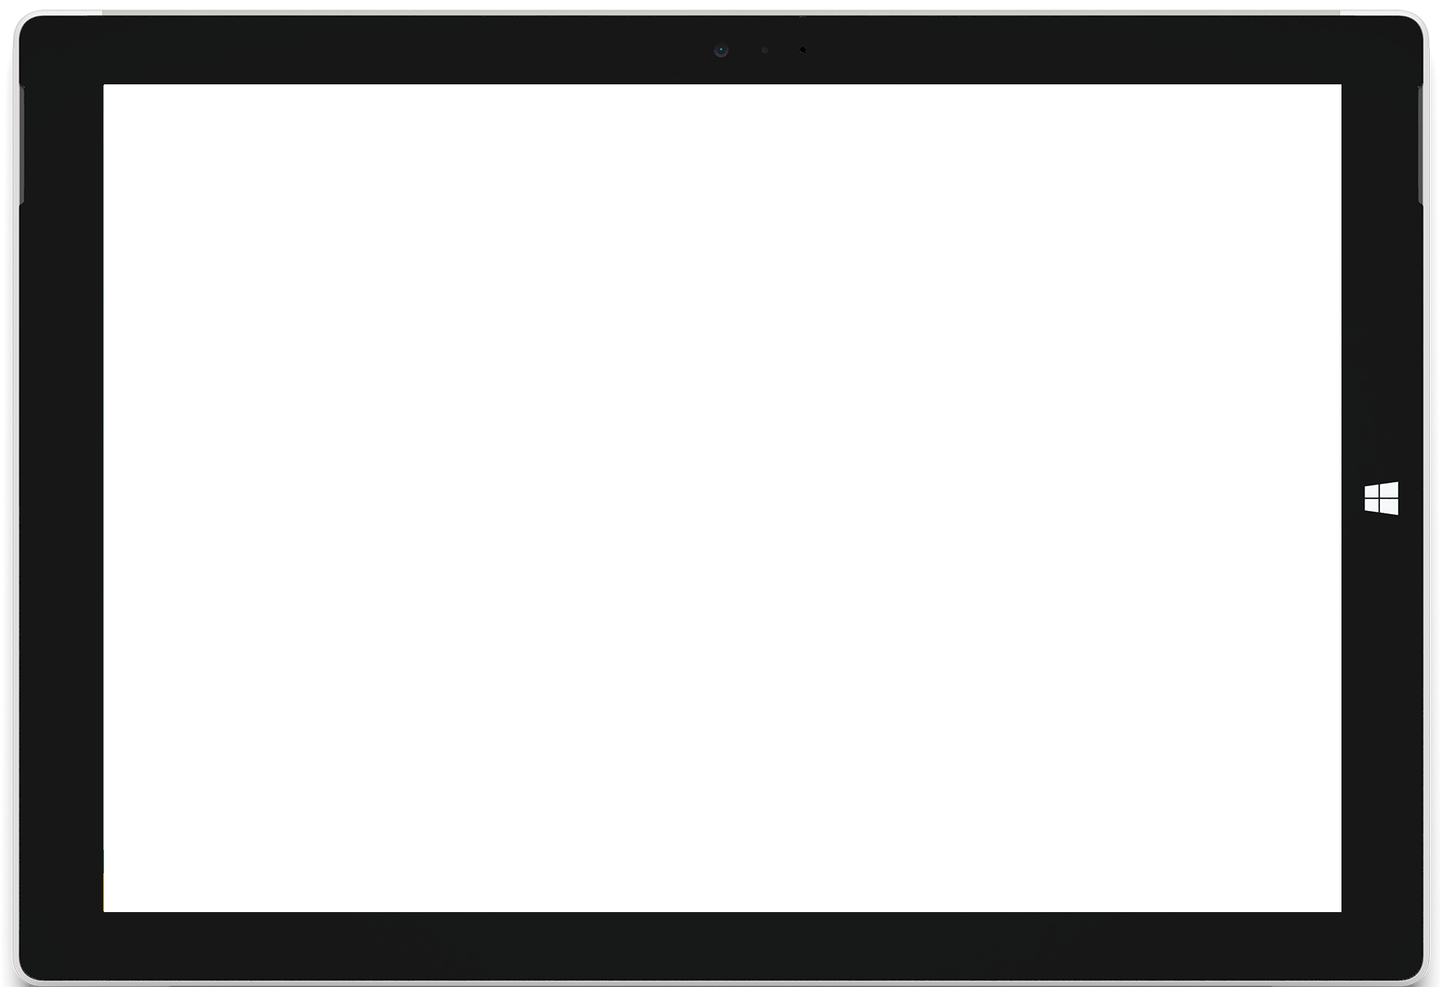
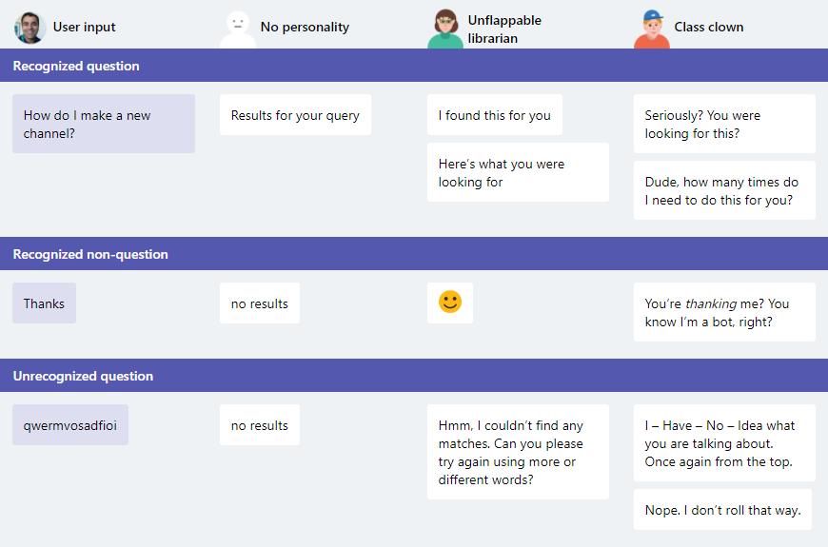
Examples of bot personality and response types

Slide 12
Conversation basics
Activity objects are used to pass information back and forth between bot and channel (or user).
Messages property
Text (Plain / Markdown)
Attachments (Simple media / Cards)
Entities (Users, Bot client)
Dialogs manage conversation flow
Pre & Post events for prompts & replies
Dialog stack and state managed by Bot Framework
Values passed to/from dialogs
StateService
User
Conversation
Private (User in Conversation)
Notes:
Dialog example (https://github.com/Microsoft/BotBuilder-Samples/tree/master/CSharp/core-BasicMultiDialog):
Root dialog calls Name dialog
Name dialog prompts for name. Upon response, returns to caller passing name via Context.Done() method
Root dialog calls Age dialog, passing name. (Pass via constructor on class)
Age dialog prompts “Hello [name], what is your age?”. Upon response, returns to caller passing name via Context.Done() method
User state applies to user for all conversations
Conversation state applies to all users in that conversation
Private state applies to current user in current conversation

Slide 13
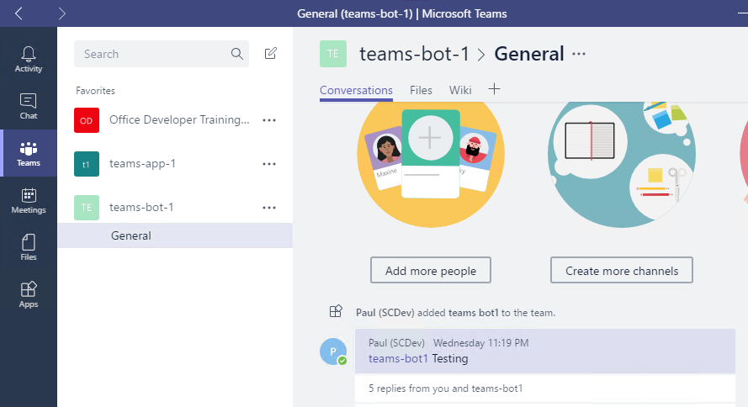
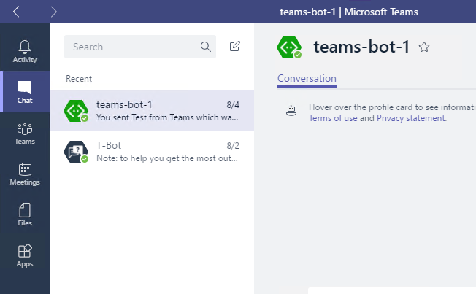
Channel conversations and 1:1 conversations
Channel conversation
Access to channel data, including members
Events when users added/removed from channel
Messages will contain ‘at’ (@) references
1:1 conversation
Access only to user – not team
Event when user initiates conversation
No ‘at’ references

Slide 14


Messages – Text formats
Format | From user to bot | From bot to user | Notes
Rich text |  |  | Basic markdown, no tables
Pictures |  |  | Maximum 1024×1024 and 1 MB in PNG, JPEG, or GIF format; animated GIF not officially supported
Cards |  |  | Currently supports Hero, Thumbnail, and Office 365 Connector cards
Emojis |  |  | Currently supports emojis via UTF-16 (such as U+1F600 for grinning face)

Slide 15
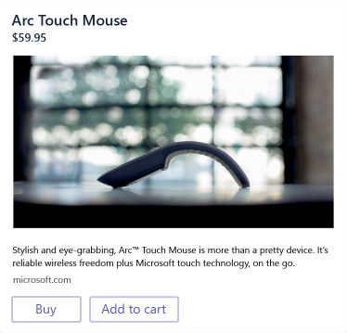
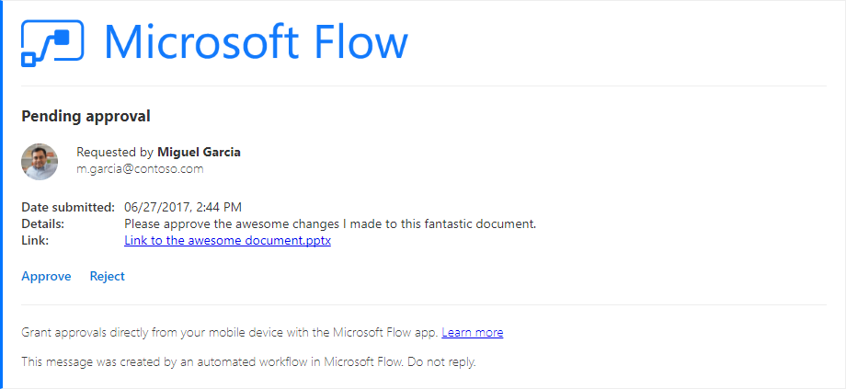
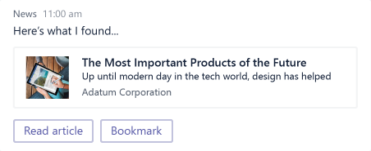
Cards
Hero
Largest card
Best used for articles, long descriptions or scenarios where your image is telling most of the story
Thumbnail
Short and sweet
Ideal for short answers, or if you want to return several cards at once to provide options
Good for deep link to tab or service
Office 365 Connector Card
Most flexible
Provides for multiple sections, images and fields
Also supported in O365 Groups (Exchange)

Slide 16
Actions
Actions require a type, value and title. The title is displayed in the card. The type/values perform specific actions:
CardAction.Type | CardAction.Value
openUrl | URL to be opened in the built-in browser
imBack | Text of the message to send to the bot (from the user who clicked the button or tapped the card). This message (from user to bot) will be visible to all conversation participants *Not recommended for bots in channels
invoke | Payload of message to send to the bot (from the user who clicked the button or tapped the card). This message will not be visible.

Slide 17
Events
Activity objects are used to pass information back and forth between bot and channel (or user). Activities can represent Events, denoted by ActivityType == ‘conversationUpdate’
Team Member Events
teamMemberAdded
teamMemberRemoved
Payload object contains added/removed members
*Adding bot fires this event
Channel Events
channelCreated
channelRenamed
channelDeleted
ChannelData object reflects current state
Team Events
teamRenamed
ChannelData object reflects current state
Notes:
Teams will send notifications to your bot for changes or events that happen in contexts where your bot is active. You can use these events to trigger service logic, such as:
Trigger welcome message when your bot is added to a team.
Query and cache team information when the bot is added to a team.
Updated cached information on team membership or channel information changes.
Remove cached information for a team if the bot is removed.
Since bot is scoped to team, no events for team creation/deletion provided.
When bot is added/removed, TeamMember events are sent.

Slide 18
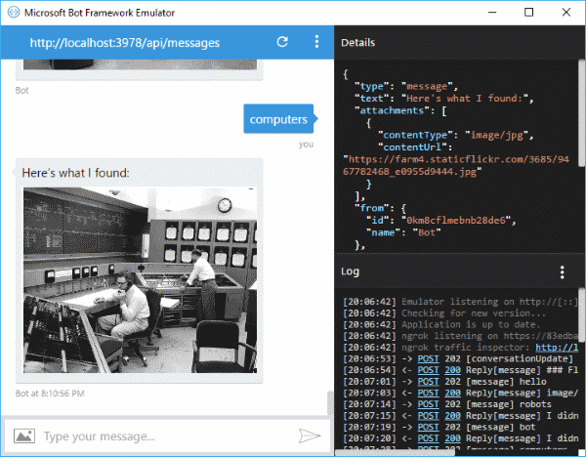
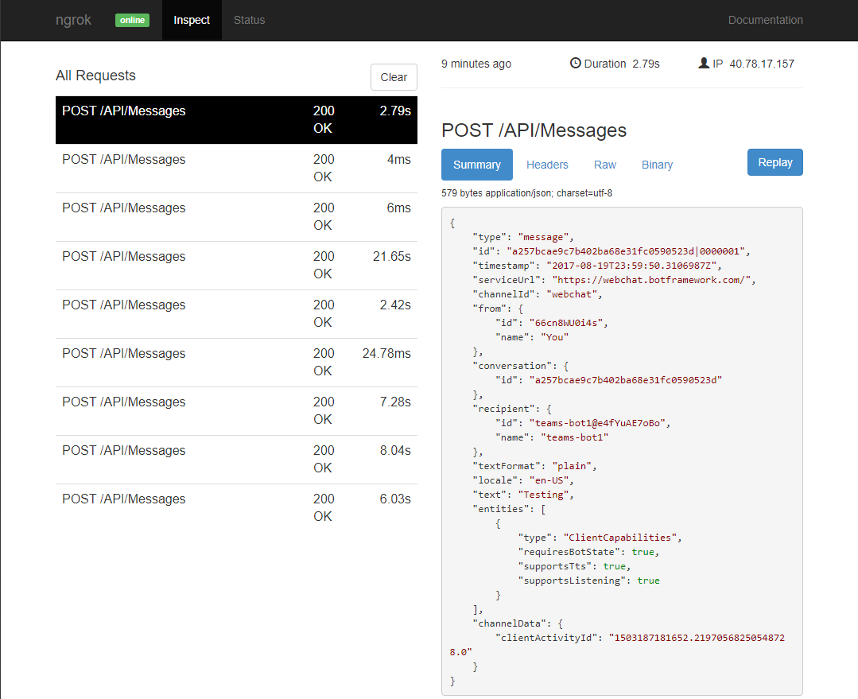
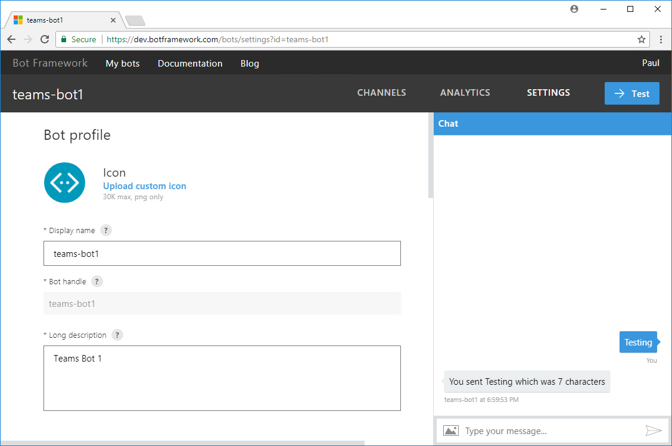
Testing your Bot
Bot registration portal
Help confirm registration settings
Simulates 1:1 conversation
Bot Framework Emulator
Separate download
Does not require registration
Can connect to bot on localhost
Supports speech recognition
Send sample Team Member Events
ngrok Tunnel
Separate download
Forwards internet requests to local machine
Allows inspection of request/response
Notes:
Emulator download page: https://emulator.botframework.com/

Slide 19
Demo Create a basic Teams Bot using Visual Studio

Slide 20
Summary
Design thought – don’t build a robot, build a bot
Deployment chain for debugging with ngrok

Slide 22

Build a Microsoft Teams Tab
Overview of building a Microsoft Teams Tab
Tab content and configuration
Interacting with Teams and External Systems
Azure Active Directory and Microsoft Graph
DEMO

Slide 23
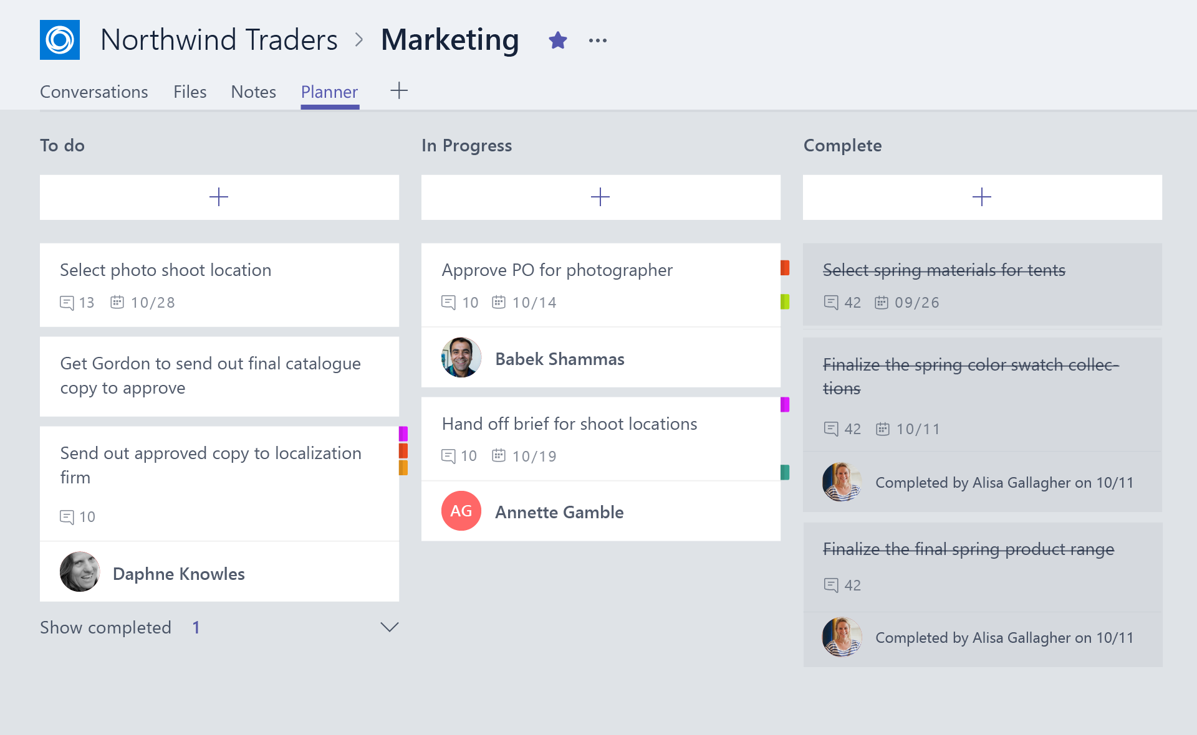
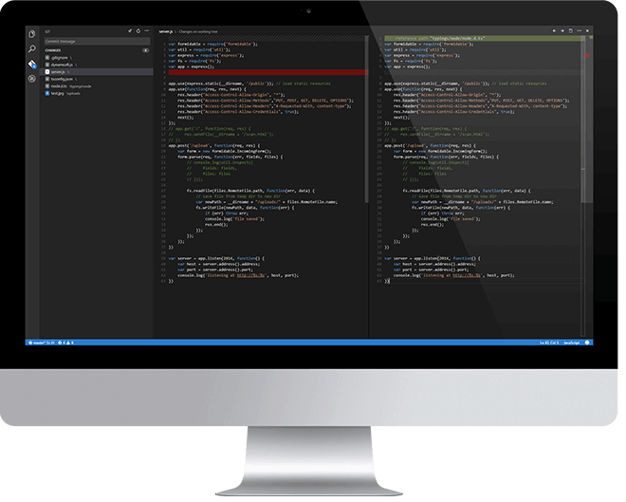
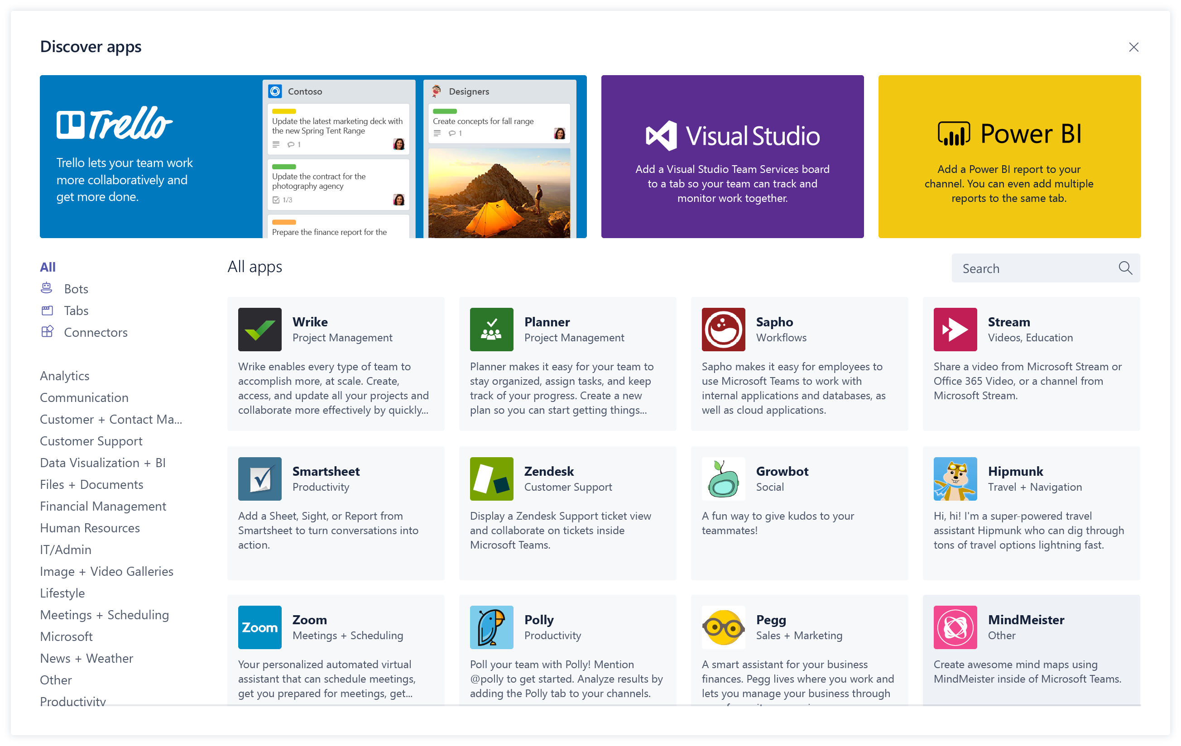
Overview of building a Microsoft Teams Tab
Design a great tab
Select relevant app functionality
Scope and focus the user experience
Integrate and streamline access
Develop your tab
HTML/JavaScript/TypeScript
REST services
Deep Linking and context
Deploy your tab
Sideload to Teams app
Submit to Office Store
Notes:
Design
Focused functionality
Tabs work best when they’re built to address a specific need. Focus on a small set of tasks or a subset of data that’s relevant to the channel the tab is in.
Reduced chrome
Avoid creating multiple panels in a tab, adding layers of navigation, or requiring users to scroll both vertically and horizontally in one tab. In other words, try not to have tabs in your tab.
Integration
Find ways to notify users about tab activity by posting cards to a conversation, for example.
Conversational
Find a way to facilitate conversation around a tab. This ensures that conversations center on the content, data, or process at hand.
Streamlined access
Make sure you’re granting access to the right people at the right time. Keeping your sign-in process simple will avoid creating barriers to contribution and collaboration.
Develop
Any editor
Call any service
Deploy
Seller Dashboard is used to submit to store
Not necessary for tabs – can sideload

Slide 24
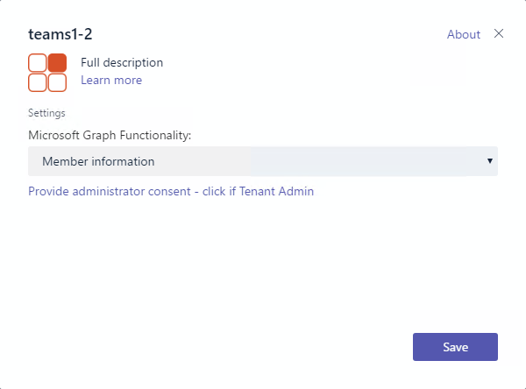
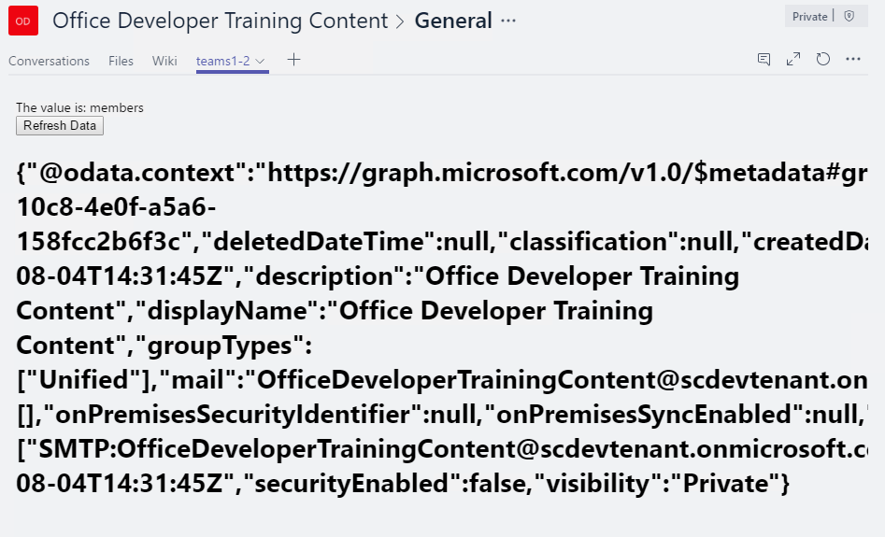
Tab Configuration and Content
Tab Configuration
Configured in manifest
Displayed when Tab added to Channel
Collect information
Call setSettings() specifying Content Url and Entity Id
Tab Content
Rendered in IFRAME
Url specified by configuration page
Inspect context for EntityId/SubEntityId
Retrieve state based on Entity/SubEntity/User
Notes:
To provide a seamless tab experience, perform provisioning and authorization on configuration page when possible.
If context has entity/subentity, then respond to a deeplink
State storage is developer’s responsibility

Slide 25
Interacting with Microsoft Teams
Teams API provides context for User / Team / Organization
Getting Context through URL placeholders
Placeholders specified in URL in manifest
Resolved at runtime
Placeholders for each property of Context object
{upn}, {teamId}
Getting Context through the JavaScript library
Library provides function to get context
microsoftTeams.getContext()
Asynchronous method with only success callback
Returns context object
Property | Description
teamId | The team ID in the format 19:[id]@thread.skype
channelId | The channel ID in the format 19:[id]@thread.skype
Locale | Lowercase lang-locale
theme | default | dark | contrast
entityId | The entity id you set up on your config page
subEntityId | The sub entity id you set up on your config page
upn | The user identifier in email format
tid | Guid identifying the current Tenant ID
groupId | Guid identifying the current O365 Group ID

Slide 26
Interacting with external services
Authenticating
Authentication cannot occur in IFRAME
Teams JavaScript library facilitates popup and cross-window communication microsoftTeams.authentication.authenticate({ url: <auth URL>, width: <width>, height: <height>, successCallback: <successCallback>, failureCallback: <failureCallback>})
In <auth URL> signal result and pass data microsoftTeams.authentication.notifySuccess(token) microsoftTeams.authentication.notifyFailure(err)
Redirecting across domains
Tabs can only show pages in validDomains list of manifest
Call microsoftTeams.navigateCrossDomain(yourNewUrl) to request the IFRAME containing your page is redirected to the specified URL.
(Could also display page in popup via authenticate)

Slide 27
Demo Call Microsoft Graph inside a Tab

Slide 28
Summary
Overview of building a Microsoft Teams Tab
Microsoft Teams Tab Authentication

Slide 29
Hands-on Labs Fundamentals of Microsoft Teams

